Slide 1
Homework 4
Front-End Web Development

Slide 2
Homework Assignment
In this homework you will:
Learn about refactoring and how developers refactor their applications.
Add a new feature to Homework 3, which you completed last week.
Introduce a new UI pattern: a modal window.
Notes:
TEACHING TIPS:
Review the concepts listed, as they should relate to things you’ve already taught them. Just jog their memory a bit.

Slide 3
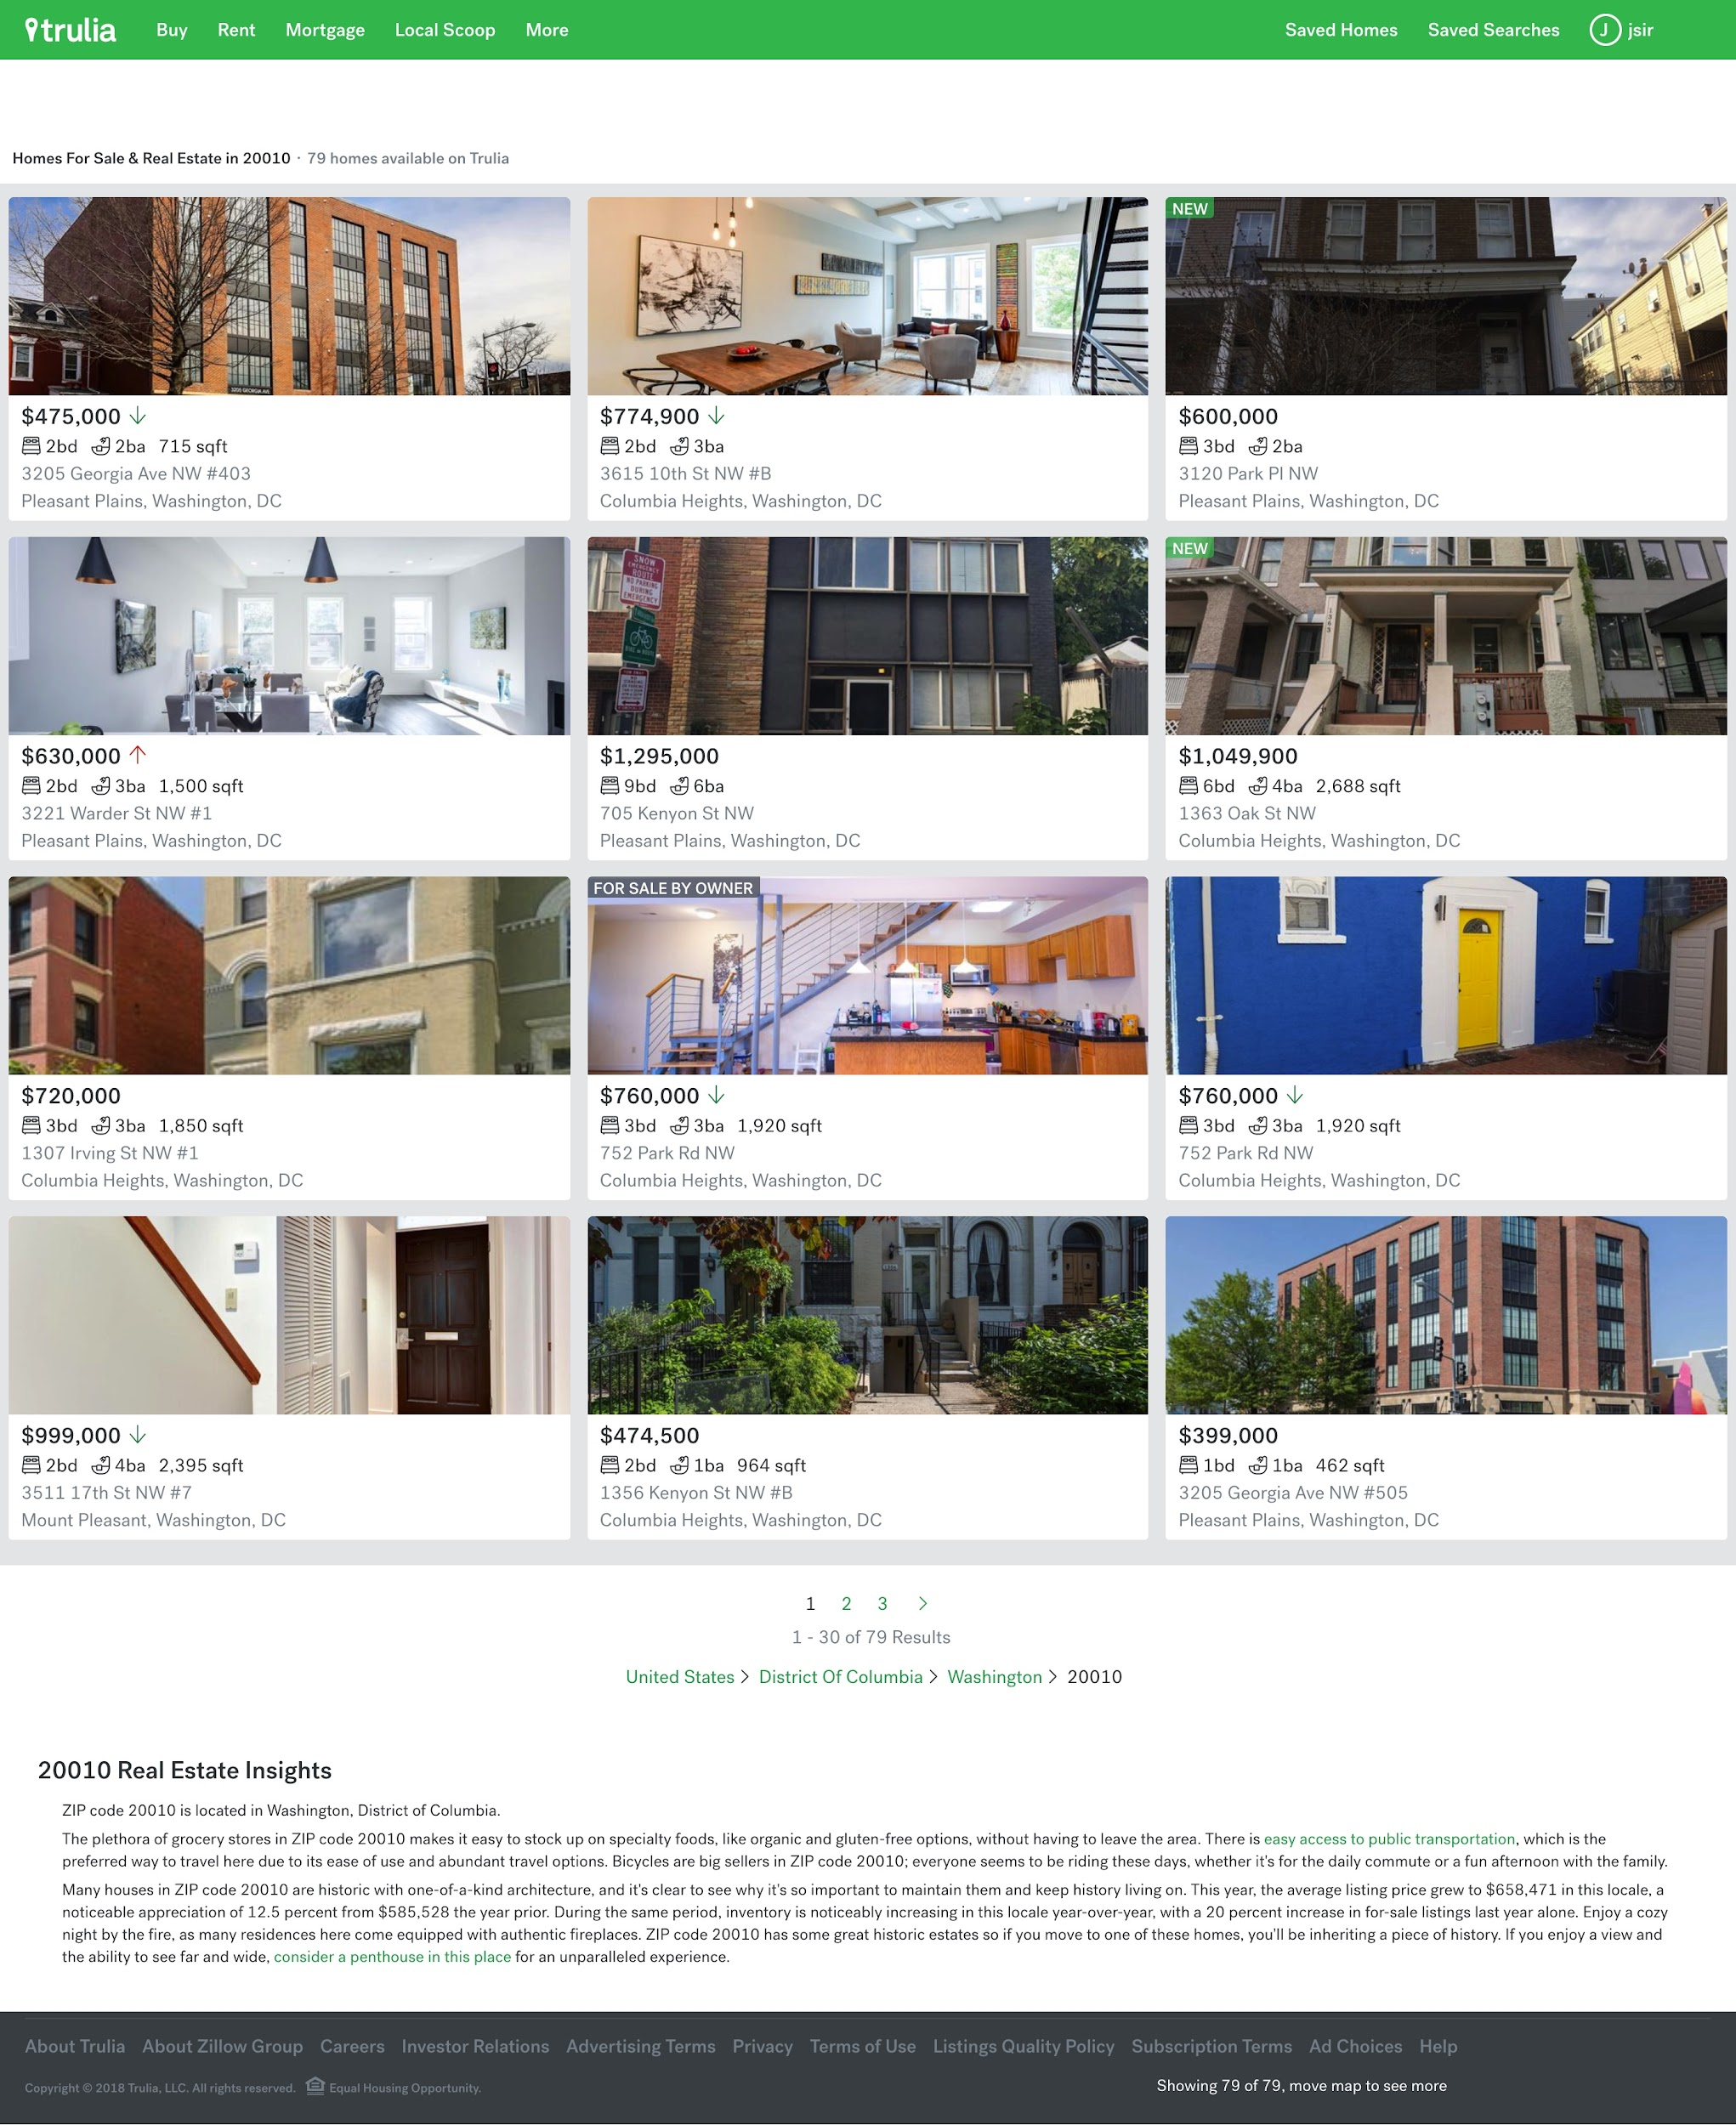
Revisit Your Trulia Assignment
In Homework 3, you should have made a page that looks something like the image on the right.
Notes:
TEACHING TIPS:
In the starter code, we’ve provided some HTML that shows students how to nest everything. You should be highlighting that, showing them why it works, etc.

Slide 4
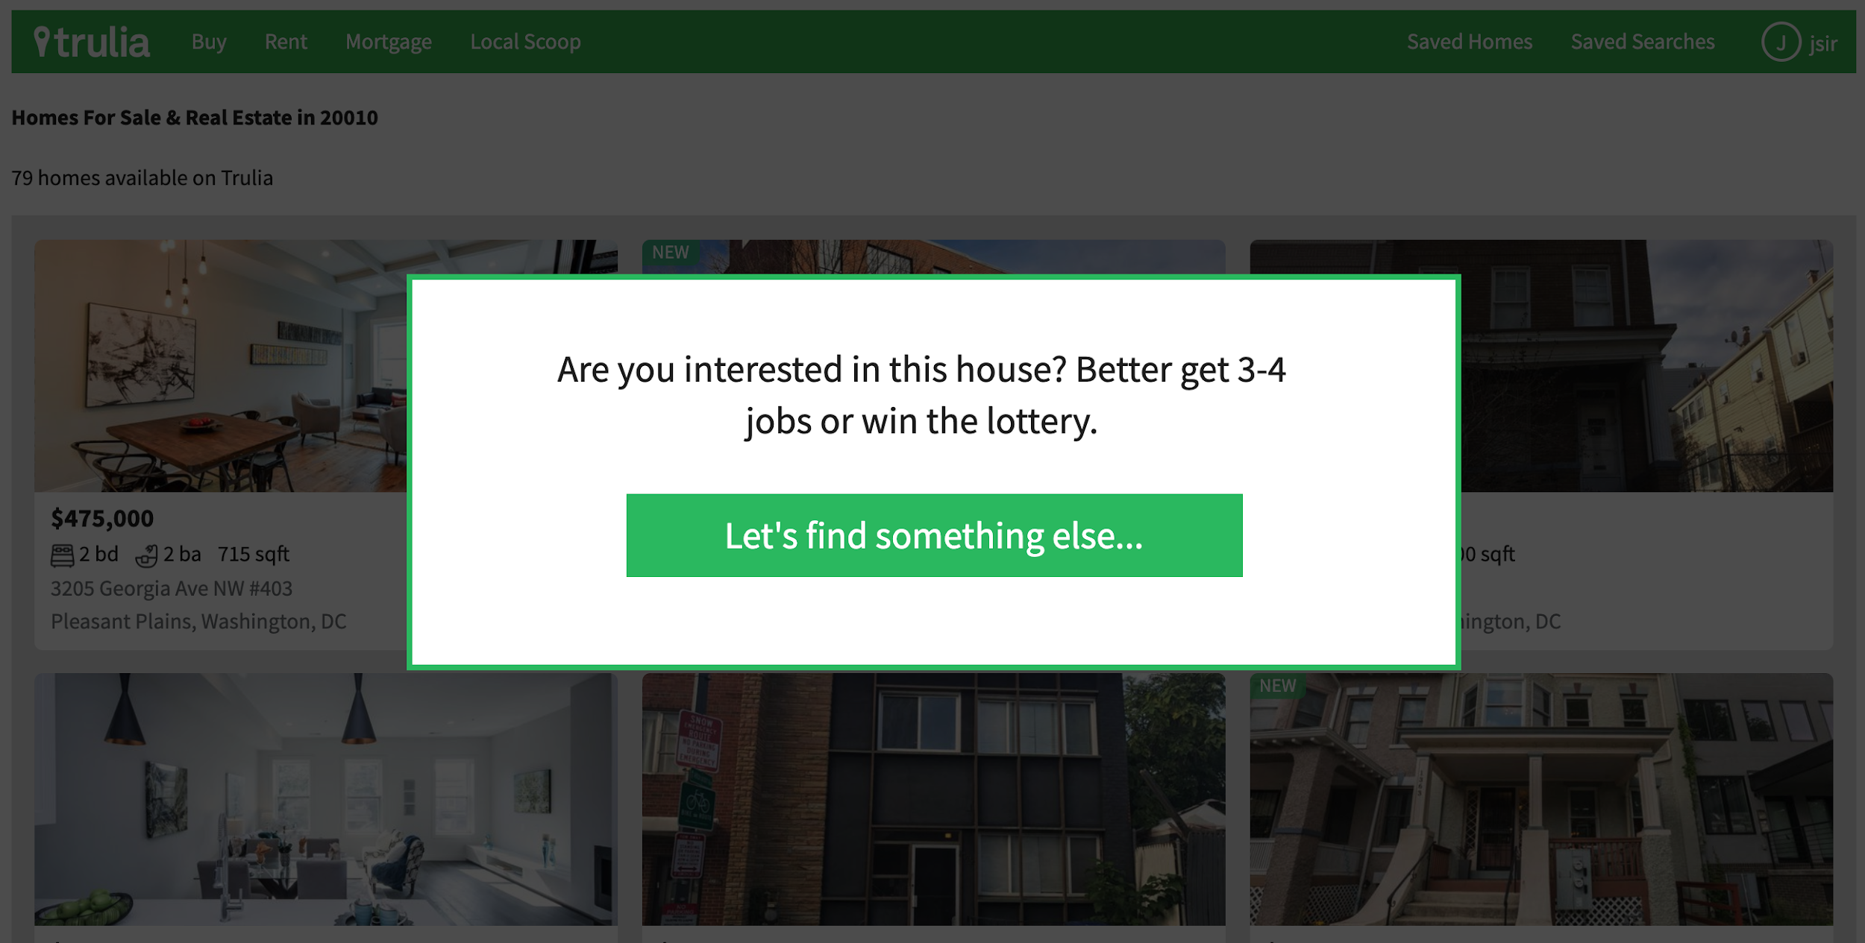
Homework 3 With a Modal Window
We’re going to be adding a modal window, which is a kind of pop-up window that appears inside of a webpage.

Slide 5
Explore the Modal Window You Build!
Explore the solution to check out how the modal window works:
https://codepen.io/GAmarketing/pen/ExjvxQw
Notes:
TEACHING TIPS:
You want to show students that it’s OK to look at an already-completed solution as a model for what they are doing.

Slide 6
Things to Consider
Think of the modal window as another layer on top of the page.
The position property puts the modal on top of the page’s content.
Remember, position pops the element out of the typical DOM rendering position (this forces us to position it manually — we want a fixed position).
Notes:
TEACHING TIPS:
This is will be difficult for students, so walk them through the assignment. It will push many of them beyond their comfort zones.

Slide 7
Your Next Step Up
This is a real-world scenario. You can work with a classmate, but you should each turn in your own assignments. Good luck!
Starter code: Homework 3
Notes:
TEACHING TIPS:
Start them off, set expectations, share the due date, etc.

